Slide 1
SOEN 384
Management, Measurement and Quality Control http://users.encs.concordia.ca/~s384_2/
Lecture 10
Management Key Area (KA) 1:
Initiation and scope definition.
Effort estimation techniques
References:
SWEBOK Chapter 7
Steve McConnell, Software Estimation: Demystifying the Black Art

Slide 2
Agenda
Management Key Area (KA) 1: Initiation and scope definition
Effort estimation techniques
Next?
soen384-F15-L10: Scope

Slide 3
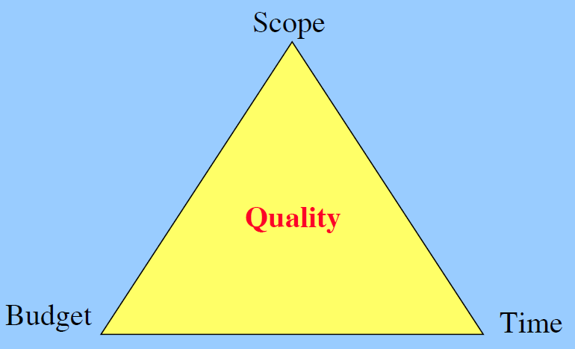
Goal and constrains of a software project
Project managers’ goal:
To delivering projects on time, within budget and according to scope and quality.
soen384-F15-L10: Scope
Notes:
Quality & The Triple constraint
source:

Slide 4
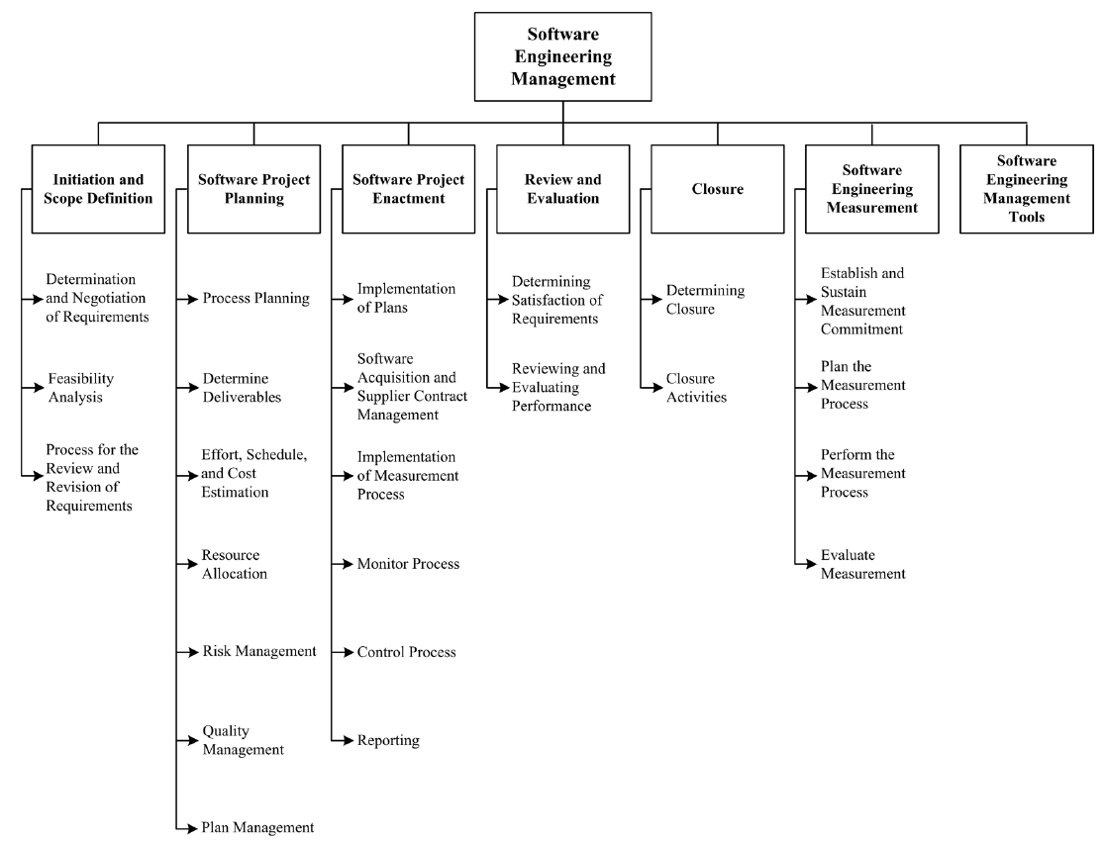
SEM KA
soen384-F15-L10: Scope

Slide 5
Software Scope Definition
(Pressman, Section 31.3.1)
The first software management activity is the determination of software scope:
  Context
  Information Objectives
  Function and performance
A statement of software scope must be bounded
  Testable FRs and NFRs
  Constraints
soen384-F15-L10: Scope

Slide 6
Initiation and Scope Definition
Deals with the decision to embark on a software engineering project
1.1. Determination and Negotiation of Requirements
1.2. Feasibility Analysis
1.3. Process for the Review and Revision of Requirements
soen384-F15-L10: Scope
Notes:
Given the inevitability of change, stakeholders
should agree on the means by which requirements
and scope are to be reviewed and revised (for
example, change management procedures, iterative
cycle retrospectives). This clearly implies
that scope and requirements will not be “set in
stone” but can and should be revisited at predetermined
points as the project unfolds (for example,
at the time when backlog priorities are created or
at milestone reviews). If changes are accepted,
then some form of traceability analysis and risk
analysis should be used to ascertain the impact
of those changes

Slide 7
Initiation and Scope Definition
1.1. Determination and Negotiation of Requirements
  Activities: requirements elicitation, analysis, specification, and validation
  Outcome: determination of project scope in order to meet objectives and satisfy constraints
soen384-F15-L10: Scope

Slide 8
SEM – KA1: Initiation and Scope Definition
1.3. Process for the Review and Revision of Requirements
  Inner consistency checking of all related documents
  Verifying against defined best practices (rules, checklists)
  One efficient way to provide feedback on the author’s work (Inspections and peer reviews)
  Plan for a managed-change approach
    Change analysis, traceability analysis and risk analysis
soen384-F15-L10: Scope
Notes:
Guidelines:
Spend at least half as much time reviewing as you spend producing it

Slide 9
Initiation and Scope Definition
1.3. Process for the Review and Revision of Requirements
Outcomes: requirements inspection procedures, change management procedures, iterative cycle retrospectives
soen384-F15-L10: Scope
Notes:
Given the inevitability of change, stakeholders
should agree on the means by which requirements
and scope are to be reviewed and revised (for
example, change management procedures, iterative
cycle retrospectives). This clearly implies
that scope and requirements will not be “set in
stone” but can and should be revisited at predetermined
points as the project unfolds (for example,
at the time when backlog priorities are created or
at milestone reviews). If changes are accepted,
then some form of traceability analysis and risk
analysis should be used to ascertain the impact
of those changes

Slide 10
SRS Inspections / Reviews: practiced in Homework 3
  Verifying against defined best practices (rules, checklists)
  One efficient way to provide feedback on the author’s work (Inspections and peer reviews)
soen384-F15-L10: Scope

Slide 11
SEM – KA 1: Initiation and Scope Definition
1.2. Feasibility Analysis
  Ensures that adequate capability and resources are available in the form of people, expertise, facilities, infrastructure, and support (either internally or externally) to ensure that the project can be successfully completed in a
  timely and cost-effective manner
soen384-F15-L10: Scope
Notes:
This often requires some "ballpark" estimation of effort and cost based on appropriate methods (for example, expert-informed analogy techniques).

Slide 12
Initiation and Scope Definition
1.2. Feasibility Analysis
Activities: description of project objectives, evaluation of alternative approaches, approximate estimations of effort and cost
Outcomes: An initial project and product scope statement, project deliverables, project duration constraints, and an estimate of resources
soen384-F15-L10: Scope
Notes:
Given the inevitability of change, stakeholders
should agree on the means by which requirements
and scope are to be reviewed and revised (for
example, change management procedures, iterative
cycle retrospectives). This clearly implies
that scope and requirements will not be “set in
stone” but can and should be revisited at predetermined
points as the project unfolds (for example,
at the time when backlog priorities are created or
at milestone reviews). If changes are accepted,
then some form of traceability analysis and risk
analysis should be used to ascertain the impact
of those changes

Slide 13
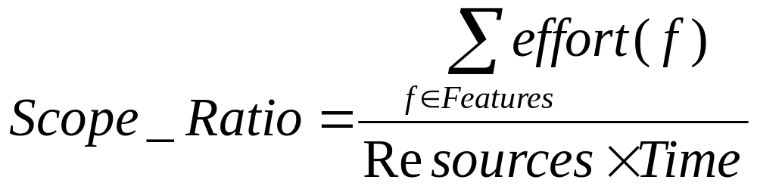
Resources (R)
Scope
Boundary
Time (T)
Features
soen384-F15-L10: Scope

Slide 14
Why Cost Estimation?
Planning new development work (schedule, effort, cost, people)
Estimating how many features you can deliver within a specific development iteration
Estimating time needed for defect correction work (maintenance)
Estimating number of developers
…
soen384-F15-L10: Scope

Slide 15
How to use effort in planning? Examples
Example1: A person working full time in a small program for 1 day:
    Duration of the activity = 1 workday*
    Work Effort = 8 person-hours
Example 2: Five persons working full time for six weeks in a project, 35 hours of work per week.
    Duration = 6 weeks
    Work Effort = (5 persons * 6 weeks * 35 hours/week) = 1,050 person-hours
soen384-F15-L10: Scope

Slide 16
Effort: "Productive" Time Only
The daily recording of only the "productive" effort, (including overtime), expended by a person on project related tasks.
Example:
  a person works on a specific project from 8am until 5pm with a 1 hour lunch break will record 8 hours of WORK EFFORT.
  when the "non-productive" tasks have been removed, (coffee, liase with other teams, team meetings, administration, read magazine, etc.), only 4 hours of PRODUCTIVE EFFORT may be recorded.
soen384-F15-L10: Scope

Slide 17
Effort: "Productive" Time Only (2)
Industrial statistics: In a typical 40-hour workweek, developers spend 20-25 hours a week in meetings, consulting on other projects, assisting marketing, or performing, etc. – tasks they generally MUST do.
  Average task hours/week is 12-15 staff hours.
  Few teams are able to achieve an average of 20 or more staff hours per week per developer without affecting the quality of the work
soen384-F15-L10: Scope

Slide 18
Simple Effort Estimation Techniques

Slide 19
Who Creates the Estimates
Individual expert judgment is by far the most common estimation approach used in practice (Jørgensen 2002)
For the estimation of specific tasks—such as the time needed to code and debug a particular feature or to create a specific set of test cases—the people who will actually do the work will create the most accurate estimates.
When creating estimates, developers, testers, and managers tend to concentrate on the tasks that they understand and deemphasize tasks that are unfamiliar to them.
soen384-F15-L10: Scope

Slide 20
Granularity
One of the best ways to improve the accuracy of task-level estimates is to separate large tasks into smaller tasks.
soen384-F15-L10: Scope

Slide 21
Individual Expert Judgment (1)
To crate the task-level estimates, have the people who will actually do the work create the estimates
Separate large tasks into smaller tasks
Create both Best Case and Worst Case estimates to simulate thinking about the full range of possible outcomes.
soen384-F15-L10: Scope
Notes:
Who Creates the Estimates
Individual expert judgment is by far the most common estimation approach used in practice(Jørgensen 2002)
When discussing "expert judgment," we need first to ask "expert in what?“
3. For the estimation of specific tasks—such as the time needed to code and debug a particular feature or to create a specific set of test cases—the people who will actually do the work will create the most accurate estimates.
Granularity
One of the best ways to improve the accuracy of task-level estimates is to separate large tasks into smaller tasks. When creating estimates, developers, testers, and managers tend to concentrate on the tasks that they understand and deemphasize tasks that are unfamiliar to them.

Slide 22
Effort estimation simple method: PERT
(Program Evaluation and Review Technique) http://www.mindtools.com/critpath.html
Helps to bias time estimates away from unrealistically short time-scales normally assumed
  Estimate the shortest possible time each activity will take (Best Case), the most likely length of time (Most Likely Case) , and the longest time (Worst Case)
Expected Case =
[Best Case + (4* Most Likely Case) + Worst Case] / 6
soen384-F15-L10: Scope
Notes:
PERT is a variation on Critical Path Analysis that takes a slightly more skeptical view of time estimates made for each project stage.

Slide 23
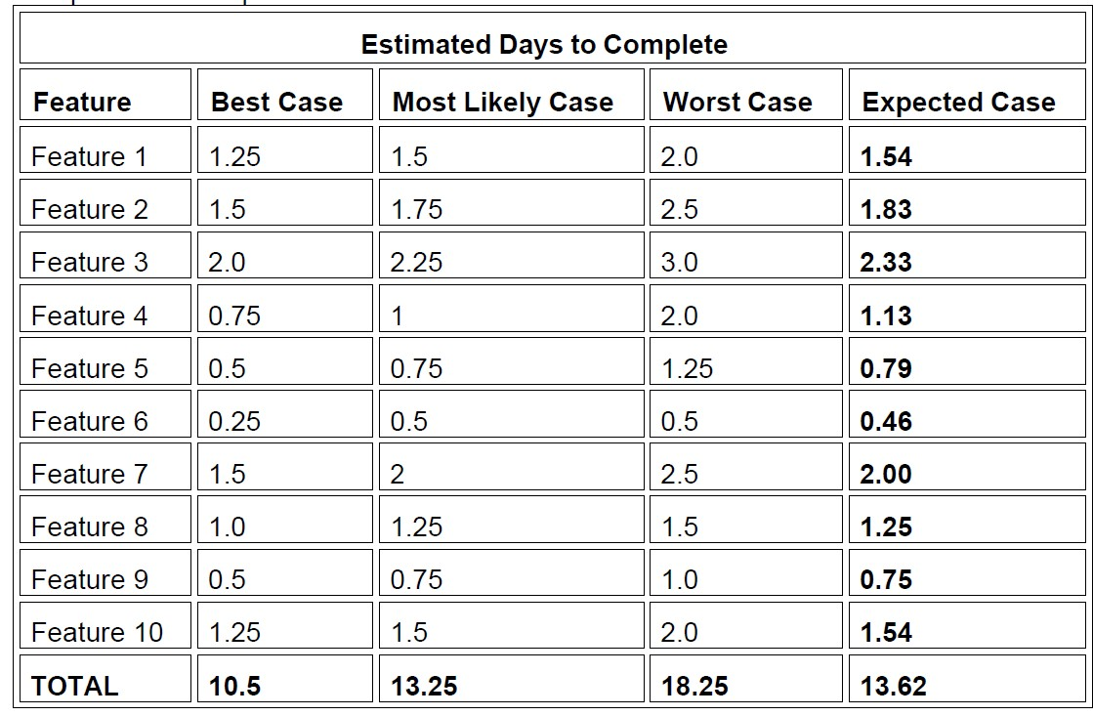
Example of Individual Expert Judgement
soen384-F15-L10: Scope

Slide 24
Individual Expert Judgment (2)
Compare Estimated Effort to Actual Effort
Magnitude of Relative Error (MRE)
  MRE (Feature) =
  |ActualResult – EstimatedResult| / ActualResult
Mean MRE:
  MMRE (project) = average of MRE (Feature)
Analyze your judgment results to avoid making mistakes in the future
soen384-F15-L10: Scope

Slide 25
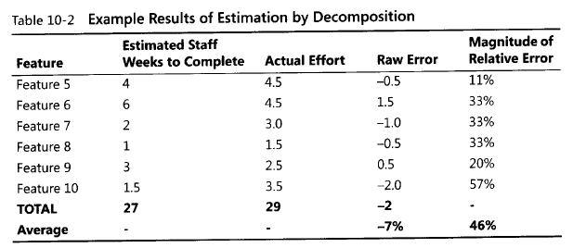
Law of Large Numbers - explanation
soen384-F15-L10: Scope

Slide 26
Law of Large Numbers
the errors on the high side and the errors on the low side cancel each other out to some degree.
soen384-F15-L10: Scope
Notes:
1.Decomposition is the practice of separating an estimate into multiple pieces, estimating each piece individually, and then recombining the individual estimates into an aggregate estimate. This estimation approach is also known as "bottom up“.
2.The gist of law of large number is that if you create one big estimate, the estimate's error tendency will be completely on the high side or completely on the low side. But if you create several smaller estimates, some of the estimation errors will be on the high side, and some will be on the low side. The errors will tend to cancel each other out to some degree.

Slide 27
Estimation by Analogy(1)
Estimate new projects by comparing them to similar past projects, preferably decomposing the estimate
What’s estimated:
  Size, Effort, Schedule, Features
soen384-F15-L10: Scope
Notes:
1.Before the new project, there was a companion project which was successful. you can create accurate estimates for a new project by comparing the new project to a similar past project.
2. eg. "The comparison to most of the old system is pretty straightforward, but the business rules part is a little tough," Jennifer said. "We think it's going to be more complicated than the old system, but we're not sure how to put a number on it. We've talked it over, and our feeling is that it's at least 50% more complicated than the old system."

Slide 28
Estimation by Analogy(2)
Step 1: Get detailed size, effort, cost results for a similar previous project
  Find the subsystems (DB, UI, Graphs/reports, Foundation classes, Business rules,…)
  Find the number of elements such as tables in DB, web pages each subsystem
  Scope out the new system
soen384-F15-L10: Scope

Slide 29
Estimation by Analogy(3)
Step 2: Compare the size of the new Project to a similar past project
  Multiplication factor (subsystem)=
  (number of elements in New) /
  (number of elements in Old)
soen384-F15-L10: Scope

Slide 30
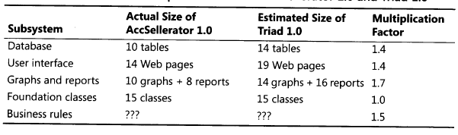
Example: AccSellerator is a past project, Triad is a new similar project
soen384-F15-L10: Scope

Slide 31
Estimation by Analogy(4)
Step 3: Build up estimate for the size of the new Project
  Size (new subsystem) = Size (old subsystem) * Multiplication factor
  Size (New project) = sum of the sizes of its subsystems
soen384-F15-L10: Scope

Slide 32
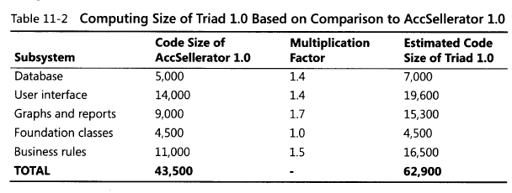
Example (cont.)
soen384-F15-L10: Scope

Slide 33
Estimation by Analogy(5)
Step 4: Create an effort estimate based on the size of the new Project
  Size Ratio =
  Size(New Project)/Size (Old Project)
  Estimated Effort (New Project) =
  Effort (Old Project) * Size Ratio
soen384-F15-L10: Scope

Slide 34
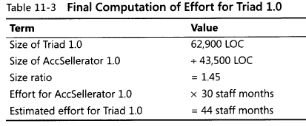
Example (cont.)
soen384-F15-L10: Scope

Slide 35
Proxy-Based Estimates
Targets whole-project or whole-iteration size estimates
Use t-shirt sizing to help no technical stakeholders rule features in or out while the project is in the wide part of the Cone of Uncertainty.
soen384-F15-L10: Scope
Notes:
1.it's difficult to directly estimate how many test cases your project will need, how many defects to expect, how many classes you'll end up with, and so on.
2. A family of estimation techniques known as proxy-based techniques helps to overcome these challenges. In proxy-based estimation, you first identify a proxy that is correlated with what you really
want to estimate and that is easier to estimate or count (or available earlier in the project) than the quantity you're ultimately interested in.

Slide 36
Proxy-Based Estimates :
T-Shirt Sizing
Supports early-in-the-project decision-making by the nontechnical stakeholders to rule out features
Apply in a project’s early stages (the wide part of the Cone of Uncertainty)
  Identify the features
  Classify the features’ size relative to other features as Small, Medium, Large, or Extra Large
  Let the stakeholders prioritize each feature’s Business Value as Small, Medium, Large, or Extra Large
  Analyze the results
    “If the cost of Feature B is Large but its business value is small, rule it out”
soen384-F15-L10: Scope
Notes:
1.Nontechnical stakeholders often want (and need) to make decisions about project scope during the wide part of the Cone of Uncertainty. A good estimator will refuse to provide highly precise estimates while the project is still in the wide part of the Cone. Sales and marketing staff will say, "How can I know whether I want that feature if I don't know how much it costs?" And a good estimator will say, "I can't tell you what it will cost until we've done more detailed requirements work." It would appear that the two groups are at an impasse.
2.This impasse can be broken by realizing that the goal of software estimation is not pinpoint accuracy but estimates that are accurate enough to support effective project control. In this case, nontechnical stakeholders are typically not asking for an estimate in staff hours. They are asking whether a specific feature is a mouse, rabbit, dog, or elephant. This observation leads to a very useful estimation approach called t-shirt sizing .
Creating this sort of relationship between business value and development cost allows the nontechnical stakeholder to say things like, "If the cost of Feature B is Large, I don't want it, because the value is only Small."

Slide 37
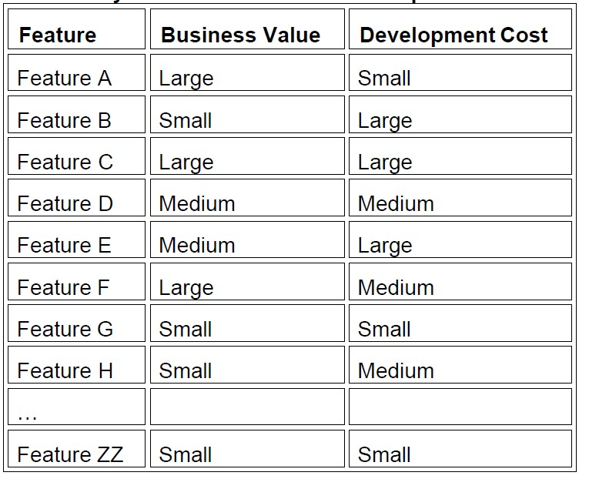
Example of Using T-Shirt Sizing to Classify Features by Business Value and Development Cost
soen384-F15-L10: Scope

Slide 38
Team Effort Estimate for a Project
(apply this soen390/490)
Have each team member estimate pieces of the project individually, and then meet to compare estimates
Discuss the differences among the individual results
Average your estimates
Arrive at a consensus estimate E that the whole group accepts
Calculate a range of effort estimation values:
  At the beginning of the project the range is within +- 40% [min, max]: min = [E * 75%, E * 125%]
  When the project advances the range is within +- 15% [min, max]: min = [E * 85%, E * 115%]
Why the effort range is wider at the beginning of the project?
soen384-F15-L10: Scope

Slide 39
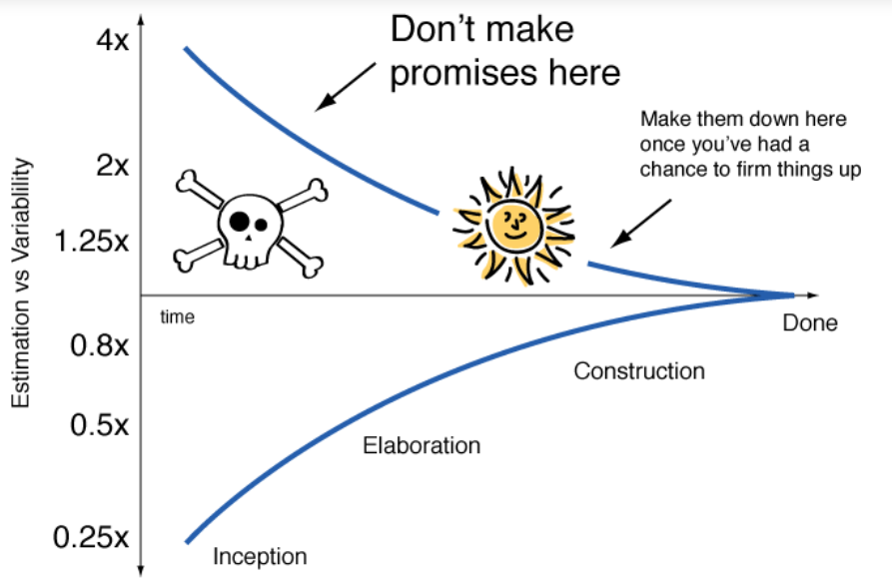
[“it is better to be roughly right
than precisely wrong”]
Use historical values
Run an iteration
Make a forecast
Use ranges
  Example:
  Estimated effort is 20 person-month
  The estimated effort is in the range
  [0.85x15p-m, 1.15x15p-m] =
  [17p-m, 23p-m]
soen384-F15-L10: Scope
Notes:
, the range of uncertainty in effort estimation is initially
much larger, and decreases with accumulated problem and solution knowledge
within a Cone of Uncertainty to determine a feasible product scope to ensure a timely delivery.

Slide 40
Sample (soen390)
Use the Feature Estimated Effort to calculate individual task effort:
Task Effort =
Feature Estimated Effort * Average task% from previous projects
Average task% from previous projects
Features | tasks | Actual Effort | Estimated effort
Feature 1 | Feature 1 tasks |  | Effort_F1
 | Management |  | Effort_F1*10%
 | Requirements |  | Effort_F1*15%
 | Design |  | Effort_F1*15%
 | Implementation |  | Effort_F1*40%
 | Quality Control |  | Effort_F1*20%
Feature 2 | Feature 2 tasks |  | Effort_F2
...
soen384-F15-L10: Scope

Slide 41
Reference
The primary purpose of software estimation is not to predict a project’s outcome; it is to determine whether a project’s targets are realistic enough to allow the project to be controlled to meet them.
—Steve McConnell, Software Estimation: Demystifying the Black Art
soen384-F15-L10: Scope

Slide 42
SEM – KA 2: 2.3. Effort, Schedule, and Cost Estimation
Based on the breakdown of activities (Work Breakdown Structure)
Inputs and outputs for each activity
expected effort range required for each activity
  determined using a estimation by analogy model based on historical size-effort data where available and relevant, or
  other methods like expert judgment.
soen384-F15-L10: Scope

Slide 43
Next?
More effort estimation techniques
soen384-F15-L10: Scope

Slide 44
Questions?
…
soen384-F15-L10: Scope

